Slide 1
A Resilience View of Business Process Re-Engineering.. & some other matters
by Adj. Assoc. Prof. Karl Reed,FACS, FIE-Aust., MSc,ARMIT
The resilience related material is primarily a report on the work of Carl Gibson, Shaharudin Ismail and Karl Reed, related to the supervision of Shaharudin Ismail’s Phd
email: k.reed@latrobe.edu.au
Rev 1.0 25/5/2015

Slide 2
What Is Organisational Resilience?
Common, Simplistic Idea
What happens to a system when some event occurs which might damage it?
Does it …
collapse?
loose some capability?
suffer a loss over short period and recover?
simply behave as if nothing happened?
Should we talk about “events which could cause change?”,
And, do we consider only “unexpected change” or “unintended change”
And, only external change?
And, are the only outcomes we are concerned about negative?
Should we consider ANY change in terms of Organisational Resilience?

Slide 3
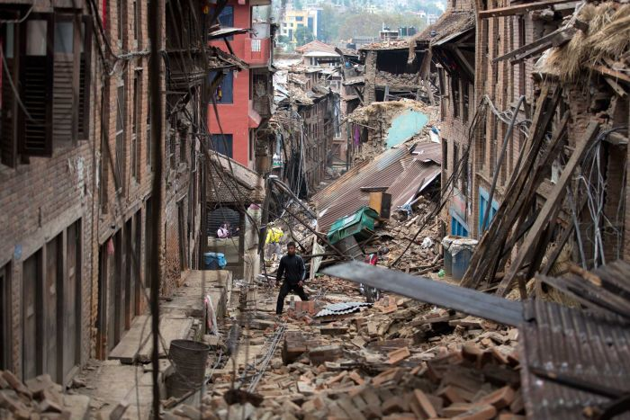
What Is Organisational Resilience?
Basic definition..
Resilience is the tendency of a system to return to some acceptable state after experiencing a (damaging) event
Nepal Earthquake
Nepalese Society(t>t₀)= R(Nepalese Society(t₀), Earthquake)
That is Nepalese Society is hit by an Earthquake at some time t₀
In this case, we consider Resilience as the extent to which the society recovers over time,
that is a function F of the delta (Nepalese Society(t>t₀)-Nepalese Society(t₀))
http://www.abc.net.au/news/image/6429296-3x2-700x467.jpg

Slide 4
What Is Organisational Resilience?
Perhaps we we’d like the delta (Nepalese Society(t>t₀)-Nepalese Society(t₀)) to go to zero, but, this may not happen, nor be desirable.
Many Reasons..
Can you suggest some?
An Abstraction….
A.1 We have an Organisation or System , S and an event which disrupts it at time t_{d} .. We will call this a Potentially Disruptive event, a PDE.
We tend to think of these in terms of the formal definition of “disruptive”, which is generally a negative change.. We’ll come back to that.
http://www.abc.net.au/news/image/6429296-3x2-700x467.jpg

Slide 5
Post PDE Impact Recovery Assuming Resilience Plan Not implemented
In the case of natural disasters, recovery often yields significant investment
and improved conditions.
p. xv The Oregon Resilience Plan – Executive Summary – February 2013

Slide 6
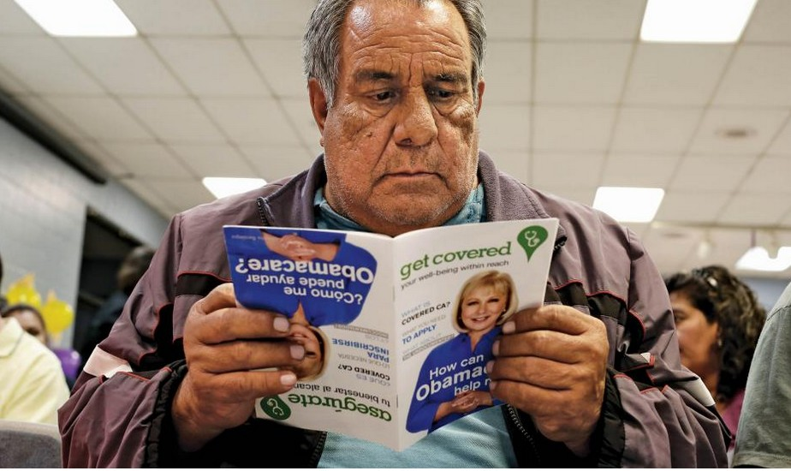
What Is Organisational Resilience?
We could also consider
US society after Obama Care
(a perturbational change)
A planned, positive event
US Society(t>t_{p})= R(US Society(t_{p}),Obama Care)
That is US Society is hit by Obama Care at some time t_{p}
In this case, we consider Resilience as the extent to which the society adjusts to the change and improves over time,
that is a function F of the delta (US Society(t>t_{p})-US Society(t_{p}) which is hoped to become positive, but bounded.
http://www.newsweek.com/2015/02/20/obamacare-picture-health-305471.html

Slide 7
Resilience Case Studies
A major part of the study of resilience involves case studies of various disasters and other catastrophes.
Usually we focus on how the system behaved during the Disruptive Event, and, seek to identify the factors that determined the outcomes, particularly the recovery and final state.
Generally, there is a tendency to treat these events in the press as either unforeseen, or, unpredictable or both where they are natural disasters such as earthquakes or tsunamis.
Often, however, there are precise predictions, or risk assessments available, or events are foreseen
¹Bryant, E(2005) Natural Hazards (2ed) Cambridge University Press
² See World Agency of Planetary Monitoring and Earthquake Risk Reduction http://www.wapmerr.org/scenario.asp for work on earthquake prediction

Slide 8
Resilience Case Studies
Lets look at some classic examples, and, note the general predictability of the event.
Predictability or “Foreseen-ness” is important because it helps in the design of resilient organisations.
We may know that something is likely to happen, but NOT exactly when.
We may know that something is likely to happen, within the next 5-50 years.
We may know that something happens at least once every 5-100 years.
We may know something is about to happen in the next 2-30 days.
¹Bryant, E(2005) Natural Hazards (2ed) Cambridge University Press
² See World Agency of Planetary Monitoring and Earthquake Risk Reduction http://www.wapmerr.org/scenario.asp for work on earthquake prediction

Slide 9
Prediction of Earthquakes and Tsunamis
"It is simply not scientifically feasible to predict, or even estimate, when the next Cascadia earthquake will occur, but the calculated odds that a Cascadia earthquake will occur in the next 50 years range from 7-15 percent for a great earthquake affecting the entire Pacific Northwest to about 37 percent for a very large earthquake affecting southern Oregon and northern California. The likelihood of a M 9 Cascadia earthquake during our lifetimes and the consequences of such an earthquake are both so great that it is prudent to consider this type of earthquake when designing new structures or retrofit of existing structures,evaluating the seismic safety of existing structures, or planning emergency response and preparedness.”
This likelihood stimulated the Oregon Resilience Plan
p.5 The Oregon Resilience Plan – Executive Summary – February 2013

Slide 10
Resilience Case Studies
Factors to be considered..
External or Internal
2. Whether the event is considered Not Foreseen, that is, was it not known to be likely to occur?
3. Immediate Impact, size and kind
4. Extent of any warning, time and precision
5. Predictability (this may be contradictory with respect to Foreseen)
6. Long term effects, recovery

Slide 11
Resilience Case Studies
System Impacted | Event
New Orleans | Hurricane Katrina
Indian Ocean Rim | Tsunami
Central Victoria Bush Fires | Black Saturday
Titanic | Iceberg
Fukishima Nuclear | Tsunami
Twin Towers NYC | 9/11
EU Mediterranean Countries | Refugee Flood
Nepal Earthquake | Earthquake
Five Eyes Disruption | Snowden Revelations
US Health Care | Obama Care

Slide 12
Resilience Case Studies
System Impacted | Event | Source/ Foreseen
New Orleans | Hurricane Katrina | Ext, Not Foreseen
Indian Ocean Rim | Tsunami | Ext, Not Foreseen
Central Victoria Bush Fires | Black Saturday | Ext, Foreseen
Titanic | Iceberg | Ext, Not Foreseen
Fukishima Nuclear | Tsunami | Ext, Not Foreseen
Twin Towers NYC | 9/11 | Ext, Not Foreseen
EU Mediterranean Countries | Refugee Flood | Ext, Foreseen
Nepal Earthquake | Earthquake | Ext, Not Foreseen
Five Eyes Disruption | Snowden Revelations | Int, Not Foreseen
US Health Care | Obama Care | Ext, Foreseen

Slide 13
Resilience Case Studies
System Impacted | Event | Source/ Foreseen | Immediate Impact
New Orleans | Hurricane Katrina | Ext, Not Foreseen | Large Neg
Indian Ocean Rim | Tsunami | Ext, Not Foreseen | Large Neg
Central Victoria Bush Fires | Black Saturday | Ext, Foreseen | Large Neg
Titanic | Iceberg | Ext, Not Foreseen | Large Neg
Fukishima Nuclear | Tsunami | Ext, Not Foreseen | Large Neg
Twin Towers NYC | 9/11 | Ext, Not Foreseen | Large Neg
EU Mediterranean Countries | Refugee Flood | Ext, Foreseen | Neg
Nepal Earthquake | Earthquake | Ext, Not Foreseen | Large Neg
Five Eyes Disruption | Snowden Revelations | Int, Not Foreseen | Large Neg
US Health Care | Obama Care | Ext, Foreseen | Neg

Slide 14
Resilience Case Studies
System Impacted | Event | Source/ Foreseen | Immediate | Warning
New Orleans | Hurricane Katrina | Ext, Not Foreseen | Large Neg | Short Lead, Precise
Indian Ocean Rim | Tsunami | Ext, Not Foreseen | Large Neg | Long Lead, Imprecise
Central Victoria Bush Fires | Black Saturday | Ext, Foreseen | Large Neg | Long Lead, Imprecise
Titanic | Iceberg | Ext, Not Foreseen | Large Neg | No
Fukishima Nuclear | Tsunami | Ext, Not Foreseen | Large Neg | Short Lead
Twin Towers NYC | 9/11 | Ext, Not Foreseen | Large Neg | No
EU Mediterranean Countries | Refugee Flood | Ext, Foreseen | Neg | Long Lead, Expected
Nepal Earthquake | Earthquake | Ext, Not Foreseen | Large Neg | Long Lead, ?
Five Eyes Disruption | Snowden Revelations | Int, Not Foreseen | Large Neg | Short Lead, ?
US Health Care | Obama Care | Ext, Foreseen | Neg | Long Lead, ?

Slide 15
Resilience Case Studies
System Impacted | Event | Source/ Foreseen | Immediate | Warning | Predictable/ Predicted
New Orleans | Hurricane Katrina | Ext, Not Foreseen | Large Neg | Short Lead, Precise | Yes/Yes
Indian Ocean Rim | Tsunami | Ext, Not Foreseen | Large Neg | Long Lead, Imprecise | Foreseeable
Central Victoria Bush Fires | Black Saturday | Ext, Foreseen | Large Neg | Long Lead, Imprecise | Yes/Yes
Titanic | Iceberg | Ext, Not Foreseen | Large Neg | No | ?/?
Fukishima Nuclear | Tsunami | Ext, Not Foreseen? | Large Neg | Short Lead | Foreseeable
Twin Towers NYC | 9/11 | Ext, Not Foreseen | Large Neg | No | ?/No
EU Mediterranean Countries | Refugee Flood | Ext, Foreseen | Neg | Long Lead, Expected | Yes/Yes
Nepal Earthquake | Earthquake | Ext, Not Foreseen | Large Neg | Long Lead, ? | Foreseeable
Five Eyes Disruption | Snowden Revelations | Int, Not Foreseen | Large Neg | Short Lead, ? | Yes/No
US Health Care | Obama Care | Ext, Foreseen | Neg | Long Lead, ? | Yes/Yes

Slide 16
Resilience Case Studies
System Impacted | Event | Source/ Foreseen | Immediate | Warning | Predictable/ Predicted | Long Term
New Orleans | Hurricane Katrina | Ext, Not Foreseen | Large Neg | Short Lead, Precise | Yes/Yes | OK
Indian Ocean Rim | Tsunami | Ext, Not Foreseen | Large Neg | Long Lead, Imprecise | Yes/yes | OK
Central Victoria Bush Fires | Black Saturday | Ext, Foreseen | Large Neg | Long Lead, Imprecise | Yes/Yes | OK
Titanic | Iceberg | Ext, Not Foreseen | Large Neg | No | ?/? | Not OK
Fukishima Nuclear | Tsunami | Ext, Not Foreseen | Large Neg | Short Lead | Yes/No | OK, NOT OK
Twin Towers NYC | 9/11 | Ext, Not Foreseen | Large Neg | No | ?/No | OK
EU Mediterranean Countries | Refugee Flood | Ext, Foreseen | Neg | Long Lead, Expected | Yes/Yes | ?
Nepal Earthquake | Earthquake | Ext, Not Foreseen | Large Neg | Long Lead, ? | Yes/No | ?
Five Eyes Disruption | Snowden Revelations | Int, Not Foreseen | Large Neg | Short Lead, ? | Yes/No | ?
US Health Care | Obama Care | Ext, Foreseen | Neg | Long Lead, ? | Yes/Yes | OK

Slide 17
Resilience Case Studies
Were these “events” predictable/foreseeable?
Predictable.. Is it possible to make a precise statement that something will happen in the future?
Foreseen.. Do we know that it is likely to happen in the future
Foreseeable.. Should it have been foreseen
Natural disasters such as earthquakes and tsunami’s are foreseeable to the point of broadly predictable in time¹ ².
E.G. Indian Ocean Tsunami was foreseen³ with suggestions for a Tsunami warning system for the Indian Ocean, and the risk of earthquakes in the Himalayas well quantifed⁴
¹Bryant, E(2005) Natural Hazards (2ed) Cambridge University Press
²The Oregon Resilience Plan – Executive Summary – February 2013
³ See http://itic.ioc-unesco.org/images/docs/ITSU_Summary_Report/itsuxv.pdf
and http://itic.ioc-unesco.org/images/docs/gitsu16.pdf
⁴See World Agency of Planetary Monitoring and Earthquake Risk Reduction http://www.wapmerr.org/scenario.asp for work on earthquake prediction

Slide 18
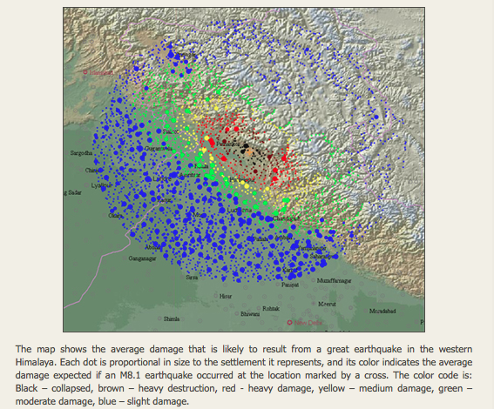
Earthquake Predictability
World Agency of Planetary Monitoring and Earthquake Risk Reduction http://www.wapmerr.org/scenario.asp

Slide 19
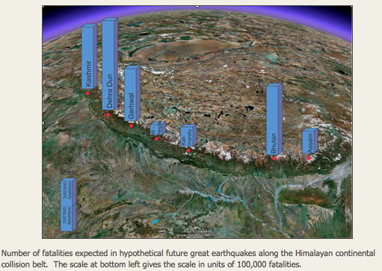
Earthquake Predictability
World Agency of Planetary Monitoring and Earthquake Risk Reduction http://www.wapmerr.org/scenario.asp

Slide 20
Resilience Organisation/Event Issues
Why stress predictability/foresee-ability?
Knowing the types of likely events and their likelihood helps determine the kind of organisation we need to achieve resilience..
It also assists economic decisions – how much are we prepared to pay for resilience, what is the ROI?
Can we identify organisation/event space agnostic properties that contribute to organisational resilience irrespective of event?
How does resilience relate to Business Process Engineering?

Slide 21
Origins of Resilience as a Concept
Historically, the ideas of resilience have been elaborated in the following¹:
Child psychology and psychiatry - living and developing successfully when facing adversity (Eagle et al., 1996);
Social psychology - is about elasticity, spirit, resource and good mood ;
Ecology - moving from a stability domain to another one under the influence of disturbances (Holling, 1973);
Material science - is about robustness and elasticity (Holling, 1996);
Business - the capacity to reinvent a business model before the circumstances force change (Hamel and Välikangas, 2003);
Industrial safety - anticipating risk changes before damage occurrence (Hollnagel et al., 2006).
¹Ismail (2012)

Slide 22
Origins of Resilience as a Concept
Three (3) dimensions of resilience in the aftermath to disaster events have been suggested²..
-Physical resilience - the ability of the people or organisations to build its physical structure including the approach, people and the politics involved in rebuilding process.
-Emotional resilience - the ability of individual, families and communities to cope and heal from trauma including the public and private efforts to grieve, commemorate and memorialize the event.
-Cultural resilience - the perseverance of cultural practices and norms through the events of great cultural trauma include the ability of customs, traditions, languages, or religions to survive and evolve.
¹Ismail (2012)
²(Kirschbaum and Sideroff, 2005b)

Slide 23
Origins of Resilience as a Concept
Brenner(2005) combined ideas from Holling(1973) and Adger (2000) and concluded that the resilience of ecologies and integrated systems of people and the environment was related to..
The amount of change the system can support, undergo and still retain the same controls on function and structure before it moves from its stable domain;
The degree of the system’s components - based on its structure and process to which the system is capable of self-organisation;
The ability to build and increase the capacity for learning and adaptation to new conditions (and survive).
¹Ismail (2012)

Slide 24
Organisational Resilience
As is clear, there are many different definitions and views¹ ..
Standard for Organisational Resilience (ASIS SPC.1-2009) provided by the American National Standards Institute gives the definition of resilience to be:-
“the capability of a system to maintain its functions and structure in the face of internal and external change and to degrade gracefully when it must”, which implies “the ability of an organisation to resist being affected by an event or the ability to return to an acceptable level of performance in an acceptable period of time after being affected by an event.” (ASIS, 2009)
None of the existing definitions in our view provided a complete picture, so we developed our own…
¹Ismail (2012)

Slide 25
Organisational Resilience
(Walker et al., 2004) defined resilience as the capacity of a system to absorb disturbance and reorganize while undergoing change so as to still retain essentially the same function, structure, identity, and feedbacks. They suggested resilience to have four components:-
- Latitude: the maximum amount a system can be changed before losing its ability to recover (before crossing a threshold which, if breached, makes recovery difficult or impossible).
Resistance: the ease or difficulty of changing the system; how “resistant” it is being changed.
Precariousness: how close the current state of the system is a limit or “threshold.”
Panarchy: because of cross-scale interactions, the resilience of a system at a particular focal scale will depend on the influences from states and dynamics at scales above and below¹.
These seem to us to be measures…
¹Ismail (2012)

Slide 26
Resilience Organisation/Event Issues
A Definition of Resilience… From Ismail Draft PhD Thesis 2012
* We can consider an organisation as a system capable of being in a set of states . A subset of these states represents normal or routine operation; that is the organisation is operating within agreed parameters and is achieving objectives acceptable to key stakeholders (in reality, routine operation may be different from the original design intention ).
* An organisation may move from the routine set of states to an abnormal or non-routine set of states as a result of the impacts of internal and/or external events.
The resultant outcomes may no longer be acceptable to stakeholders and the organisation can be said to have failed, totally or partially, and to have not exhibited resilience.
* Conversely, if the outcomes from this non-routine state are acceptable, then the organisation has demonstrated resilience to these disruptive events.
* Resilience, in our view, is exhibited by an organisation which, in the lead up to or after some disruptive event, reaches some stable point of functionality that allows some or all of an organisation's objectives to be met to some degree.
* This may be a result pre-planned, predictable, stable, variation within understood, measured, controlled, planned and acceptable boundaries.
This is not a one directional movement. There can be movement up and down the sequence of states. Furthermore some transitional states may last only moments, or may jump straight to a different, stable but abnormal state. (Gibson, Reed and Ismail 2012)
.

Slide 27
Resilience and BPE… Change Management
*Frequently, a BPM/BPE exercise will involve organisational change, with a stated goal of improved efficiency in an existing business…
The BPM/BPE exercise can be considered as a Disruptive¹ Event, moving the organisation from its current (normal) states to a new set of states..
However, the natural resilience of an organisation, that is, the tendency to either absorb or adapt change to maintain the status quo, may impede the adoption of new business processes.
Also, the (new) BPM/BPE needs to maintain or increase organisational resilience..
¹We may need to refine this term to Perturbative. Disruptive is a special case

Slide 28
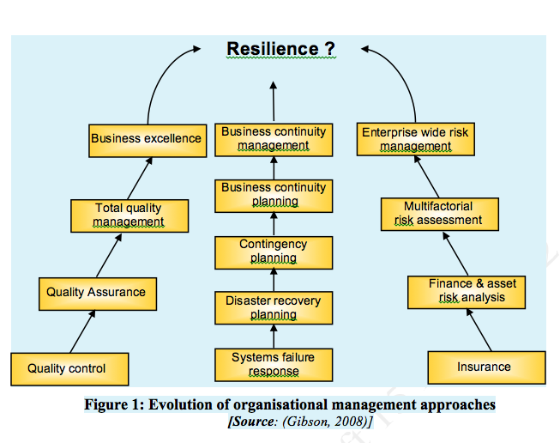
The Development of Resilience
*

Slide 29
Systems of Systems and Their Resilience
In practice, a large disaster impacts a collection of systems, each with different resilience characteristics, instantly and over time.
In the case of the Black Saturday Bushfires in Victoria, some 30km from where I live, on 9th of Feb 2009..
-Once in Millennium Draught almost no rain for two months, 46C on the day,(predicted)
-100-125KMPH winds during the fire (high winds predicted)
-173 dead, 2,030 homes lost, four small towns completely destroyed
-400,000 hectares destroyed…
-more than 19,000 CFA (volunteers) involved
http://www.cfa.vic.gov.au/about/black-saturday/
PARLIAMENT OF VICTORIA 2010. 2009 Victorian Bushfires Royal Commission: Final Report. Melbourne: Parliament of Victoria.

Slide 30
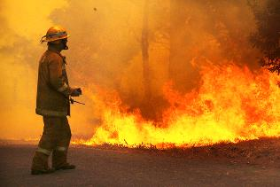
Black Saturday Bushfires Victoria 9/2/2015
http://www.cfa.vic.gov.au/about/black-saturday/
PARLIAMENT OF VICTORIA 2010. 2009 Victorian Bushfires Royal Commission: Final Report. Melbourne:
heraldsun.com.au

Slide 31
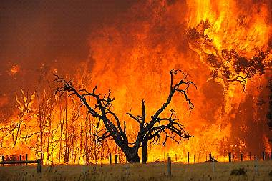
Black Saturday Bushfires Victoria 9/2/2015
easymix.com.au

Slide 32
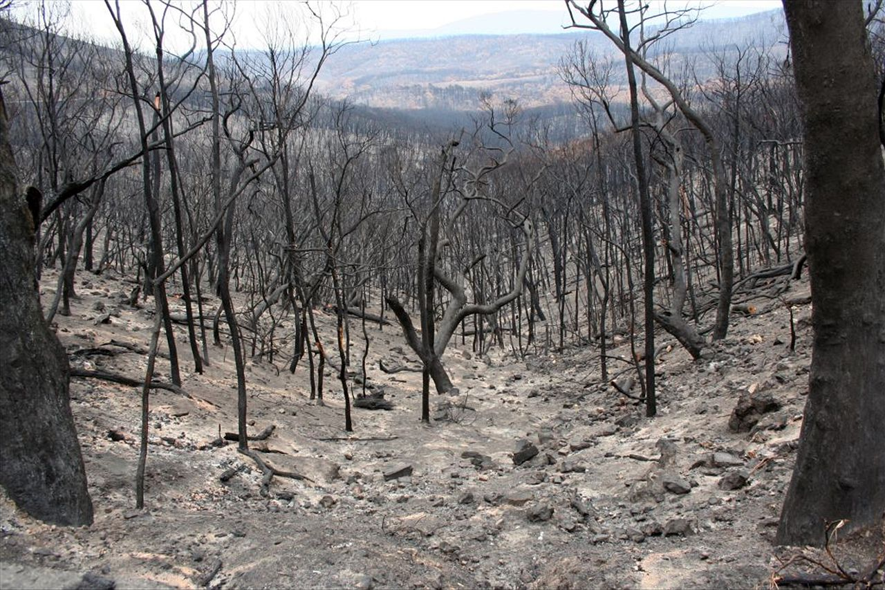
Black Saturday Bushfires Victoria 9/2/2015
Abc.net.au

Slide 33
Black Saturday
Actor | Immediate R | Short Term R | Medium Term R | Long Term R
Environment | V. Low |  |  | Recovered
Communities Affected | V.Low | Medium | High | Recovered
Donor Community | V. High | High | - | -
Emergency Services | Excellent Brave Effort, High | Medium | High | High
Reconstruction | Low | Low | Medium | High
Utilities | Low | Medium | High | Recovered
Policy | Poor | - | Medium | Revised
In all cases, these assessments have to be qualified.. And, really, different attributes assessed
Individuals and communities showed strength and courage, but, suffered massive losses. Many never recovered.
Some base support services did not cope..
Reconstruction was slow to start, but, I think came good.
Major policy changes were made to advisories..

Slide 34
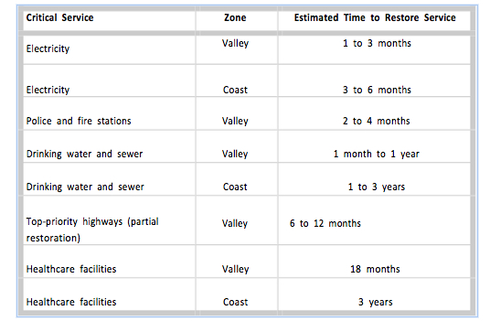
System of Systems Resilience from the The Oregon Resilience Plan
Recovery from Tsunami under present conditions
p.xx The Oregon Resilience Plan February 2013

Slide 35
Issues Considered During the Research
Amongst the ideas being considered..
-Sources of non-human Resilient systems.. Safety Critical, High Reliability Networks, Adaptive Systems,
-Apparent Resilience.. Emergency Services, Fire Brigades, Police etc. that is, organisations that plan to deal with crises,
-Internally generated events, intentional and unintentional,(cf. BPE, EU Med. Refugees), hence our creeping fatigue model,
-Generic classes of events,
-And eventually, Resilience Capability.. (See also CMU-SEI RMM)

Slide 36
Resilience Organisation/Event Issues
Impact of incremental PDE From Ismail Draft Phd Thesis 2012
Sudden shock/
creeping failure
Series of disruptive events
Survive and continue to function
performance
collapse
time
The EU Mediterranean refugee crisis is a good example

Slide 37
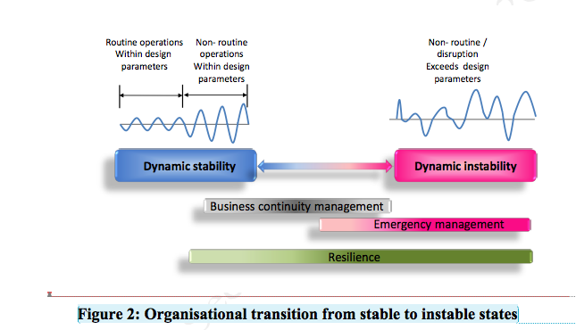
The Development of Resilience

Slide 38
Resilience Capability-The Concept
After a detailed analysis of a wide range of case studies, and an assessment of available tools for assessing resilience, it was decided that a research particular outcome was required…
Possibilities were..
A. Given a characterisation of an organisation, and its environment, and of the kind of Potentially Disruptive Events (PDE’s) that it may face, could we predict its response, in resilience terms?
B. Further, could we predict the PDE’s that organisation would not be able to cope with?
C. Would we need to focus only on the Organisation and its Environment to achieve a usable result?
This lead us to a Capability Model Approach, building on the classic CMM/CMMI approach. (Hi-risk CMU-SEI were also looking at this..)

Slide 39
Resilience Capability-The Concept
Semi-Formally..
Consider an organisation O operating in an environment E subject to a set of PDE’s P.
Can we construct an evaluation process F(O(t₁),E(t₁),P(t₁)) whose result is O’(t₂)= F(O(t₁),E(t₁),P(t₁)), (1)
that O’(t₂) is the Organisation after the impact of the PDEs.
If it was decided to develop model C, one in which there was a capability function C(O(t₁),E(t₁)) (2)
from which the organisations sensitivity to a PDE set could be determined.
Our conceptual equation becomes..
O’(t₂)=F_{c}(C(O(t₁),E(t₁)), P(t₁)) (3)

Slide 40
Resilience Capability-The Concept
Looking at our Goal C, we are seeking a function V, which would tell us what the set of PDE’s that O was vulnerable to was like. We could call V vulnerability.
That is P’=V(C(O(t₁),E(t₁))) (4)
These equations are only conceptual, in practice an assessment process would be needed to do the work¹..
¹We don’t exclude a formal approach, it was not, however, our starting point.

Slide 41
Factors Determining Resilience Capability
The case studies yield a wide range of attributes that appear relevant to Resilience capability..
One of these, expressed abstractly, is the existence of skill substitution sources to compensate for staff losses or shortages..
In Katrina, it is Mississippi Power reached out to utility companies in other areas to increase their work force from 1200 to 11,000 to restore power to the effected areas¹ . This requires good relations with the other members of the “community”, plus, common skills and shared standards. We found community as an element of environment figured in a number of case-studies.
¹(Wildman, 2006)

Slide 42
Factors Determining Resilience Capability
Another is emergent leadership, which can manifest itself at all levels of an organisation.
Analysis a variety of natural disasters show that emergent leadership is important. We regard this as an important research question.
However, there are other examples where governance and professional standards or their absence seems to have been pivotal. The failure of managers at Marshall and Thiokol to advise the shuttle program of known (or knowable) faults in the case joints (O ring) was a major factor in the Challenger Shuttle disaster¹.
¹(Rogers Commission, 1986)

Slide 43
Factors Determining Resilience Capability
In many cases, where natural disaster is known to be likely, there is often a failure in pre-planning on an institutional or national scale.
We have discussed the fact the Tsunami’s were known to be likely in the Indian Ocean, however, despite this, there was no warning system in place prior to December 26 2004.
There have Tsunami warning systems in the Pacific Ocean since the end of WW II.
To be effective, our Resilience Capability Model needs to reveal the precise areas of planning, as well as other organisational attributes ,that need to be improved.

Slide 44
Additional Issues-
Other views….
NAT .. Normal Accident Theory.. systems with interactive complexity and tight coupling will experience accidents that cannot be foreseen or prevented, which is known as ‘system accidents’ (Perrow, 1984).
HRO… High Reliability Organisations.. handling complex technologies without generating major accidents. organisational redundancy and a capacity of organisations to reconfigure in adaptation to peak demands and crisis (Størseth et al., 2009) are features¹. Governance , leadership and transparency related issues figure highly in the examples used here.
¹See also Rochlin G. I., La Porte T. R. and Roberts K. H.(1987) The Self-Designing High-Reliability Organization: Aircraft Carrier Flight Operations at Sea Naval War College Review Autumn 1987 pp.76-90 http://www.caso-db.uvek.admin.ch/Documents/MTh_SM_22.pdf . Also Leveson et al., 2009

Slide 45
Additional Issues-
Black Swans¹.. Taleb argues that there are inherently unknowable future events, and, implies that these are so common that the only way of dealing with them is to expect the unknowable.
While we accept that there are collections of events that are difficult to predict, we suggest that in fact, many “unknown unknowns” exist only in the minds of those without adequate domain expertise!
It is true that many modern fighter aircraft, following the example of the Swedish SAAB Grippen JAS39 are continuously aerodynamically unstable^{2.} Disaster management, and for that matter, other crisis handling organisations may benefit from this “planned instability”, but, it IS planned!
¹TALEB, N. N. 2007. The Black Swan, New York, Random House
²http://www.aeroflight.co.uk/aircraft/types/saab-jas-39-gripen.htm.

Slide 46
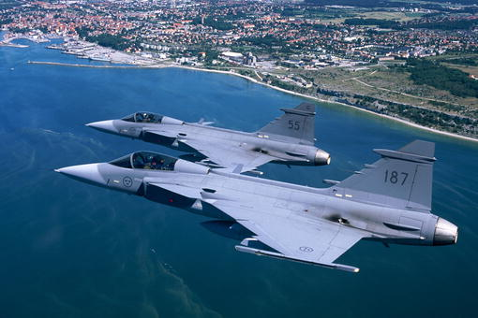
Additional Issues-
Black Swans¹.. Taleb argues that there are inherently unknowable future events, and, implies that these are so common that the only way of dealing with them is to expect the knowable.
While we accept that there are collections events that are difficult to predict, we suggest that in fact, many “unknown unknowns” exist only in the minds of those without adequate domain expertise!
It is true that many modern fighter aircraft, following the example of the Swedish SAAB Grippen JAS39 are continuously aerodynamically unstable²
²http://www.aeroflight.co.uk/aircraft/types/saab-jas-39-gripen.htm.

Slide 47
Resilience Capability Models
The work reported here involved merging a CMM-like framework with established quality assessment frameworks taking into account the attributes identified as influential during the case studies and literature reviews.
So far, two models have been developed, and, further work is being undertaken to improve, validate and simplify them.
A fundamental issue is methods for determining values for becomes a large data acquisition exercise.
These need to be sufficiently prescriptive to allow validation of the data.
As an example of this problem, we need to have a method for establishing the nature of emergent leadership characteristics.
In addition, there may be basis for using a GQM style approach for tailoring the method for individual cases.

Slide 48
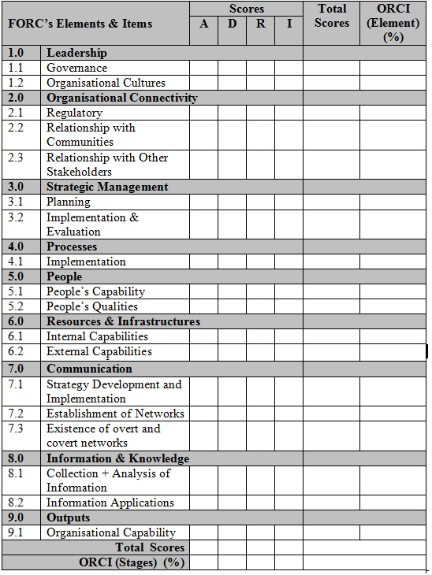
Resilience Capability Models What does it Look Like?
FORC I a sample Table
ORCI(attribute) is the overall % score for each attribute/capability obtained by summing scores of DIMC across each attribute, out of a possible maximum score of 40.
ORCI (attribute) = ((Total scores for all items for specific attribute) / (Number of items x 40)) x 100

Slide 49
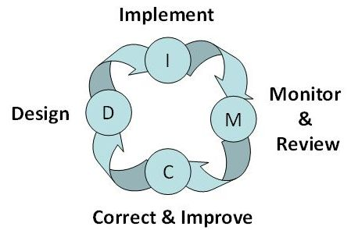
Resilience Capability Models What does it Look Like?
Figure 6: The DIMC Cycle Ismail 2012

Slide 50
Finally
This presentation draws very heavily upon the work of Carl Gibson Shaharudin Ismail and myself. It is a great delight to work with them. I have been as careful as I can to reflect their views where appropriate, however, any errors or mistakes are my responsibility alone!
Many Thanks!

Slide 51
References 1 of 2
ASIS SPC.1-2009 - Organisational Resilience: Security, Preparedness, and Continuity Management Systems - Requirements with Guidance for Use, Alexandria, Virginia, American National Standards Institute
ADGER, W. N. 2000. Social and ecological resilience: are they related? Progress in Human Geography, 24, 347–364
Allen J. H. and Davis N.(2010) Measuring Operational Resilience Using the CERT Resilience Management Model Carnegie-Mellon University/Software Engineering Insititute CMU/SEI-2010-TN-030
Basil V., Trendowicz A., Kowalczyk M, Heidrich J. Seamen C., Munch J. and Rombach D (2014),, Aligning Organizations Through Measurement The GQM+ Strategies Approach The Fraunhofer IESE Series on Software and Systems Engineering Springer 2014
BRENNER, J. 2005. Fish indicators of coastal ecological resilience. MarBEF Newsletter. Dublin Ireland: Marine Biodiversity and Ecosystem Functioning (MarBEF)
Bryant, E(2005) Natural Hazards (2ed) Cambridge University Press
CFA(2012) About Black Saturday http://www.cfa.vic.gov.au/about/black-saturday/
GIBSON, C. A. & TARRANT, M.( 2010). A 'conceptual models' approach to organisational resilience. The Australian Journal of Emergency Management, 25, 6-12.
EAGLE, P. L., CASTLE, S. & MENON, P. 1996. Child Development: Vulnerability and Resilience. Social Science and Medicine, 43, 621-635
EICHENWALD, K(2015) Obamacare Is the Picture of Health, Newsweek February 9, 2015 http://www.newsweek.com/2015/02/20/obamacare-picture-health-305471.html
Gibson, Reed and Ismail (2012) unpublished communications to the authors
HOLLING, C. S. (1973). Resilience and Stability of Ecological Systems. Annual Review of Ecology and Systematics, 4, 1-23
HAMEL, G. & VÄLIKANGAS, L. 2003. The Quest for Resilience. Harvard Business Review
HOLLNAGEL, E. 2006. Resilience – the Challenge of the Unstable. In: HOLLNAGEL, E., WOODS, D. D. & LEVESON, N. G. (eds.) Resilience Engineering: Concepts and Precepts. Aldershot, Hampshire, England; Burlington, VT: Ashgate

Slide 52
References 2 of 2
KIRSCHBAUM, J. B. & SIDEROFF, D. 2005b. A Delayed Healing: Understanding the Fragmented Resilience of Gernika. In: VALE, L. J. & CAMPANELLA, T. J. (eds.) The Resilient City: How Modern Cities Recover From Disaster. Oxford: Oxford University Press
PARLIAMENT OF VICTORIA 2010. 2009 Victorian Bushfires Royal Commission: Final Report. Melbourne: Parliament of Victoria
Rochlin G. I., La Porte T. R. and Roberts K. H.(1987) The Self-Designing High-Reliability Organization: Aircraft Carrier Flight Operations at Sea Naval War College Review Autumn 1987 pp.76-90 http://www.caso-db.uvek.admin.ch/Documents/MTh_SM_22.pdf . Also Leveson et al., 2009
ROGERS COMMISSION 1986. Report of the Presidential Commission on the Space Shuttle Challenger Accident
SAAB JAS 39 Gripen Aircraft Profile http://www.aeroflight.co.uk/aircraft/types/saab-jas-39-gripen.htm
TALEB, N. N. (2007). The Black Swan, New York, Random House
The Oregon Resilience Plan (2013) The Oregon Resilience Plan Reducing Risk and Improving Recovery for the Next Cascadia Earthquake and Tsunami http://www.oregon.gov/OMD/OEM/osspac/docs/Oregon_Resilience_Plan_Executive_Summary_Final.pdf
WALKER, B., HOLLING, C. S., CARPENTER, S. R. & KINZIG, A. 2004. Resilience, adaptability and transformability in social–ecological systems. Ecology and Society, 9, 5.
WILDMAN, T. 2006. Every Customer Lost. Transmission and Distribution World. Penton Media Inc.
World Agency of Planetary Monitoring and Earthquake Risk Reduction http://www.wapmerr.org/scenario.asp
Intergovernmental Oceanographic Commission Reports of Governing and Major Subsidiary Bodies International
Co-ordination Group for the Tsunami Warning System in the Pacific Fifteenth Session Papetee, Tahiti, French Polynesia, 24-28 July 1995 http://itic.ioc-unesco.org/images/docs/ITSU_Summary_Report/itsuxv.pdfhttp://itic.ioc-unesco.org/images/docs/gitsu16.pdf
http://www.abc.net.au/innovation/blacksaturday/#/stories/mosaic
http://www.abc.net.au/news/image/6429296-3x2-700x467.jpg

